Slide 1




02 March 2026
EcoCash Website Monthly Report Analysis

Slide 2


02 March 2026
This report aims to analyze the website's performance for February 2026, focusing on traffic, user flow, traffic sources, demographics, behaviors, and security.
What Is The Purpose Of This Report?
Key metrics
Traffic overview
Audience demographics
Behavior analysis
Acquisition channels
Conversion tracking
Areas Of Focus:

Slide 3



02 March 2026
Summary
Performance of the website based on data insights
In the past month, the EcoCash website attracted a total of 26K active users, with 23K being new and 6,1K returning users, these are people who have visited the website multiple times. The majority of users accessed the site through organic search (21,9K users), while smaller numbers came via direct (4,7K users). Zimbabwe contributed the highest traffic, with 21K users. On average, users engaged with the site for 42s per session.

Slide 4
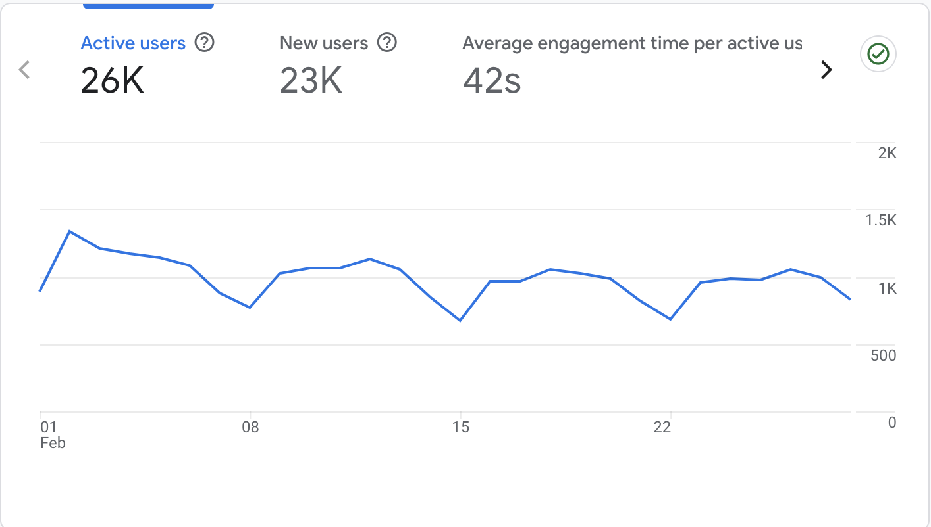
02 March 2026
Site Overview
Emphasizing the important numerical data, the large line chart on the right displays the key metrics for the EcoCash website from the previous month.
It shows:
Users : 26K total users visited the site.
New Users : 23K new users, indicating most visitors were first-time visitors.
Average Engagement Time : Users spent an average of 42s seconds on the site.

Slide 5
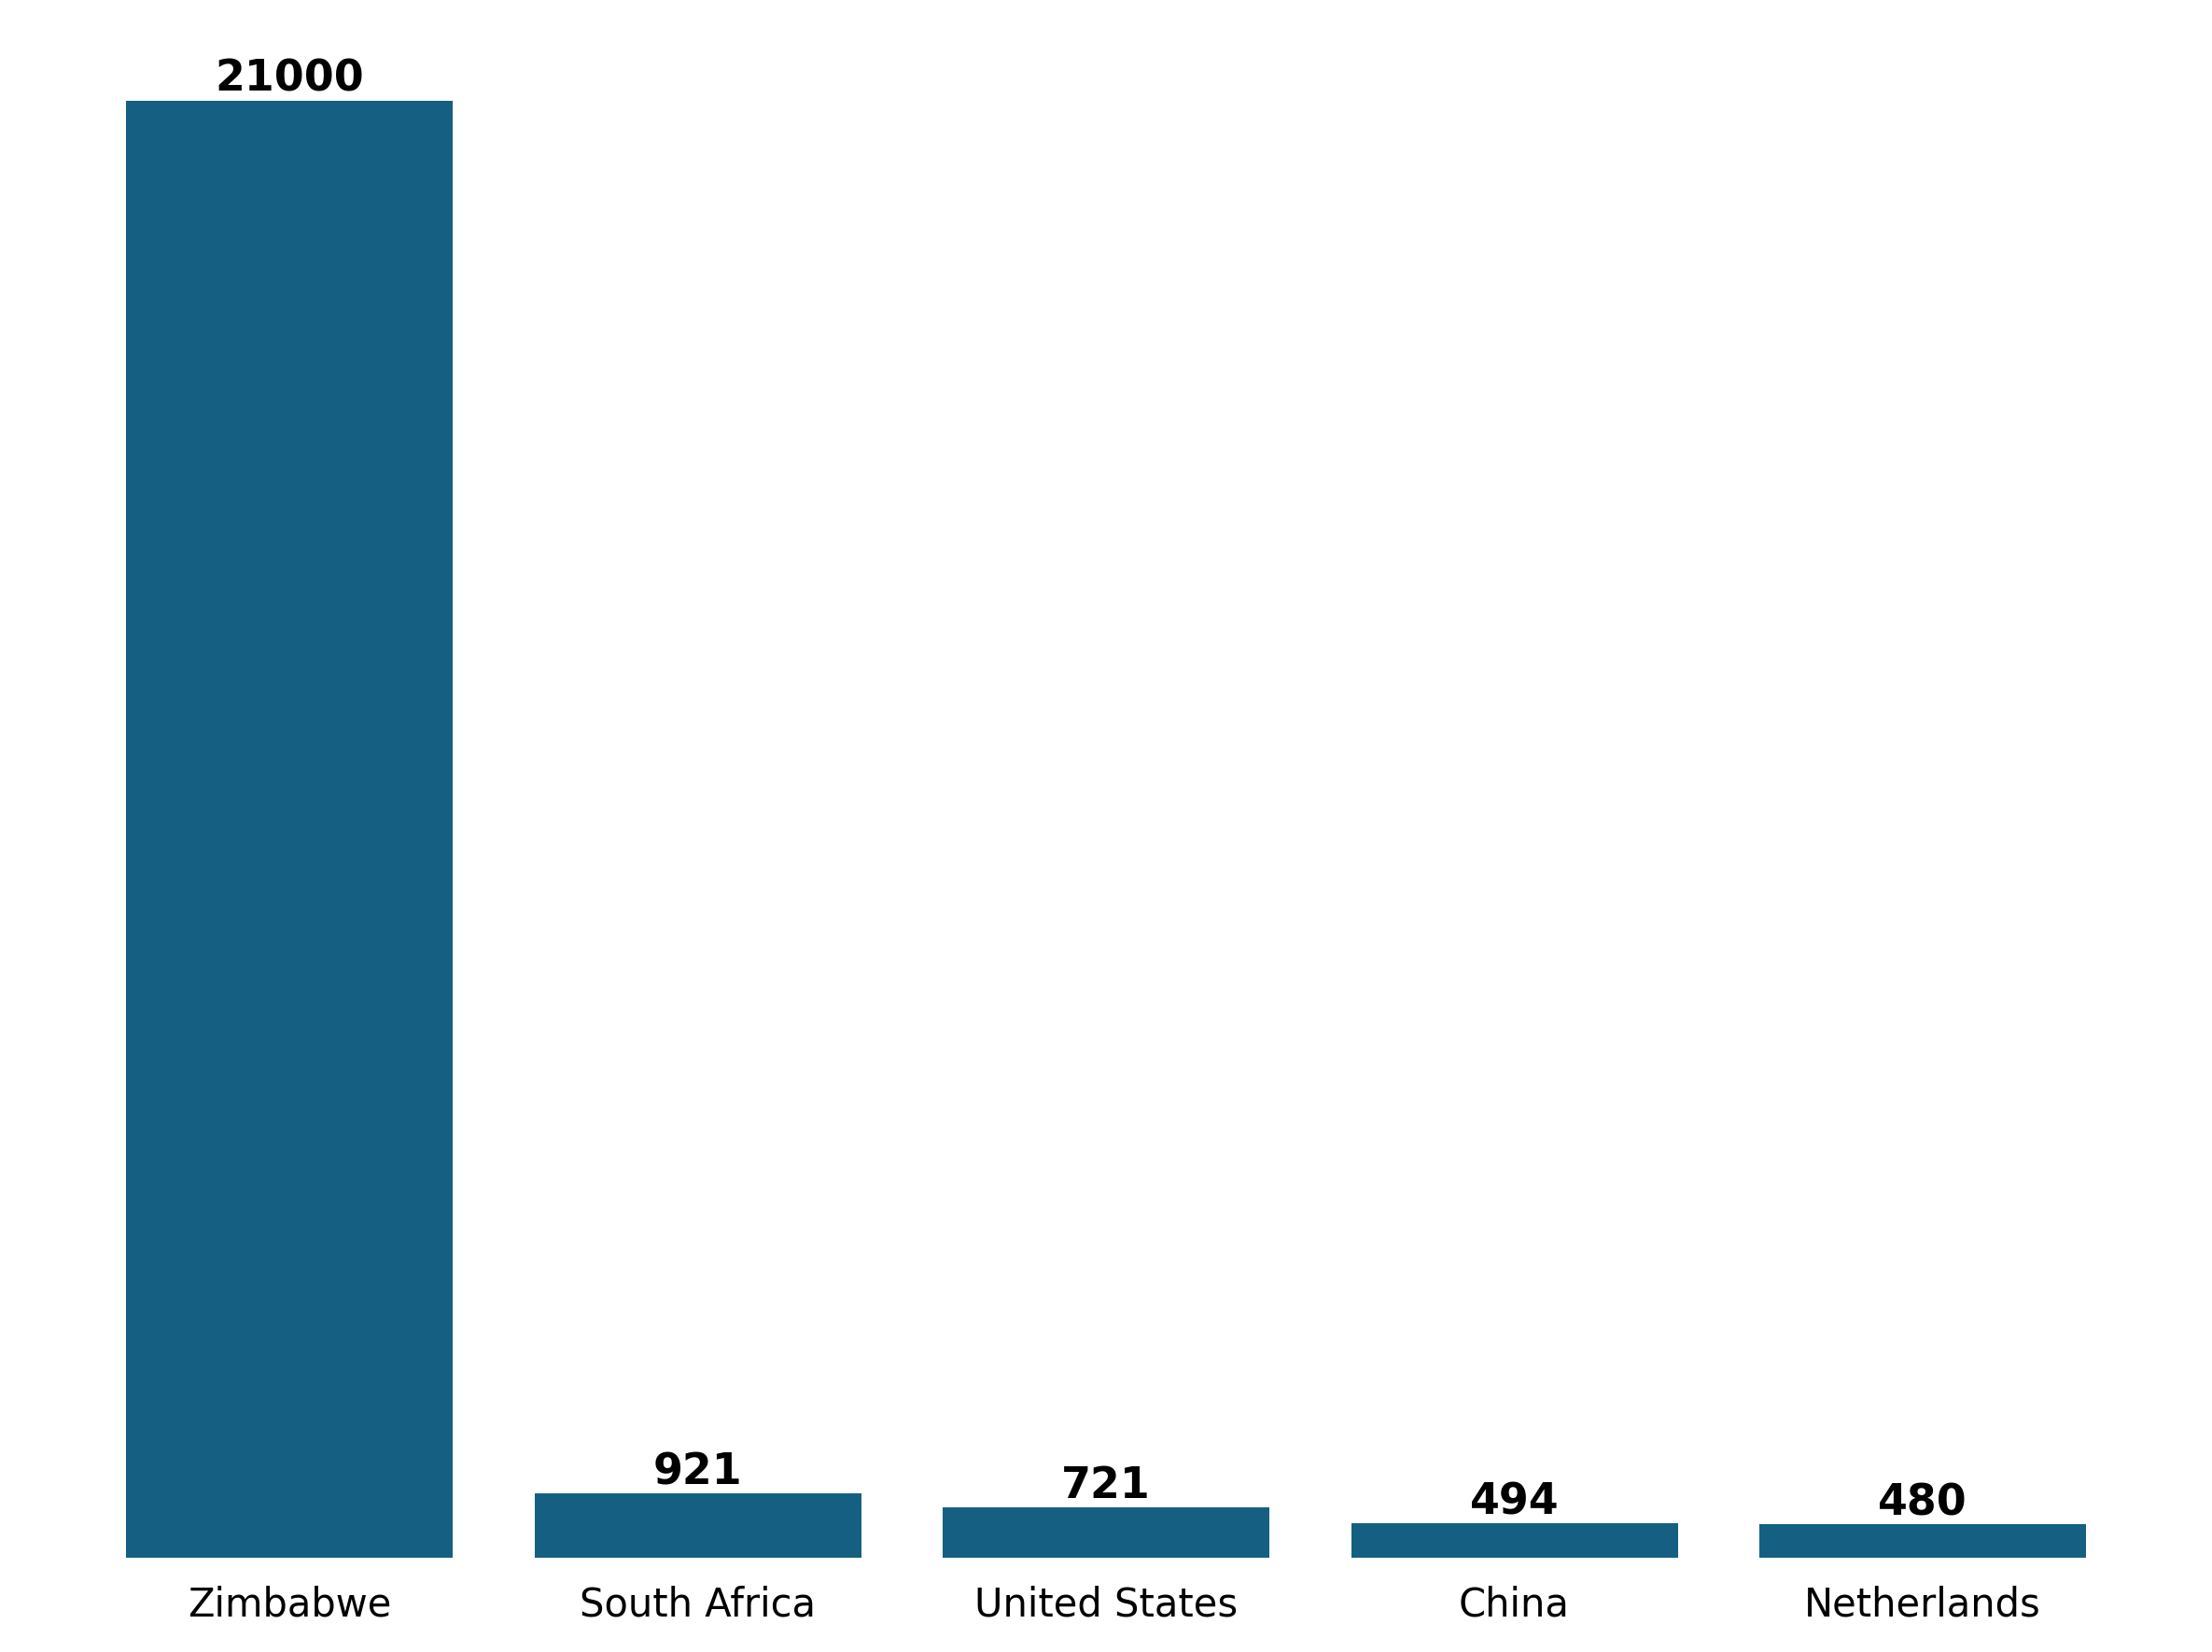
02 March 2026
Demographic Overview
Most of the traffic is coming from Zimbabwe(21K users) , followed by South Africa with (921 users) then United States with (721 users) and China with (494 users) each.

Slide 6
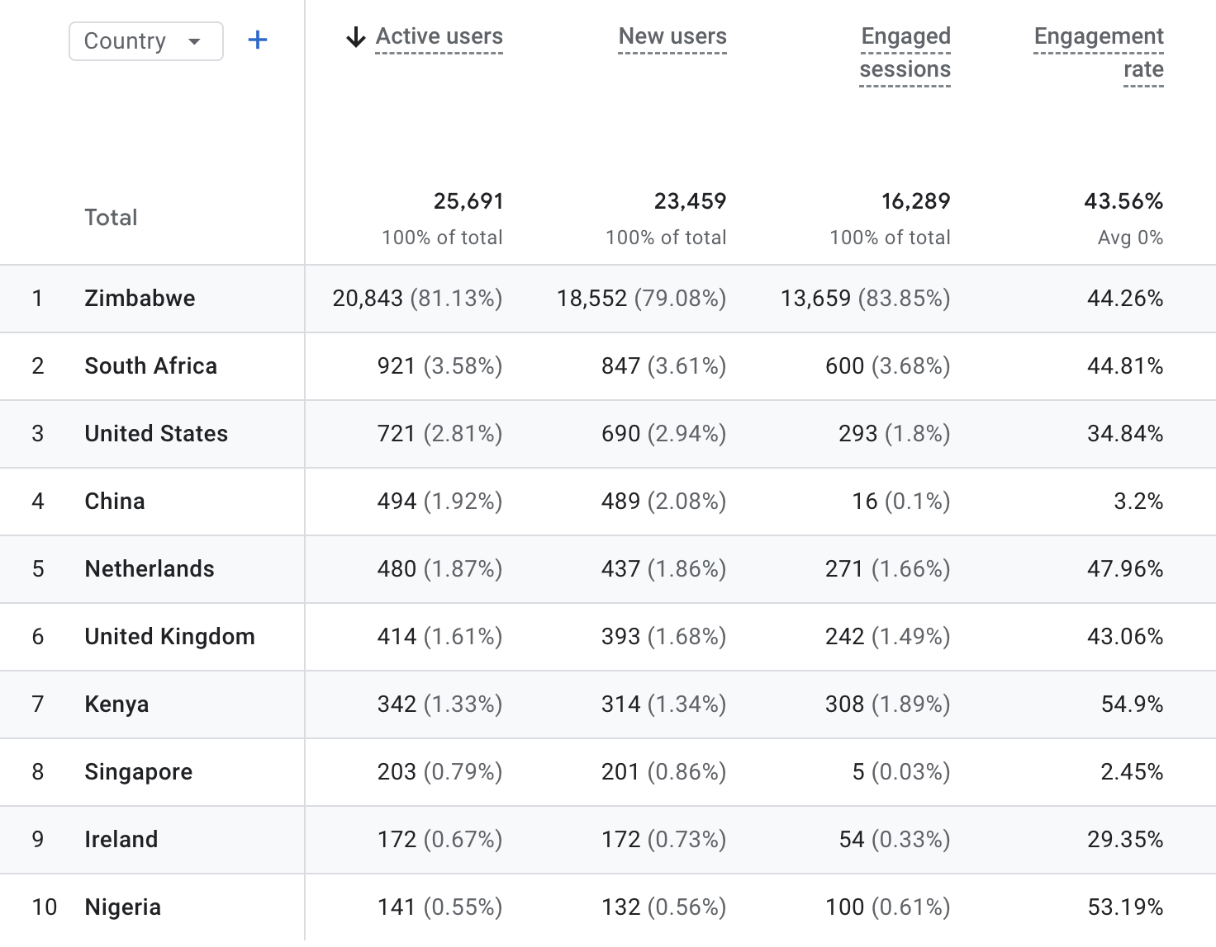
02 March 2026
Demographic Overview

Slide 7
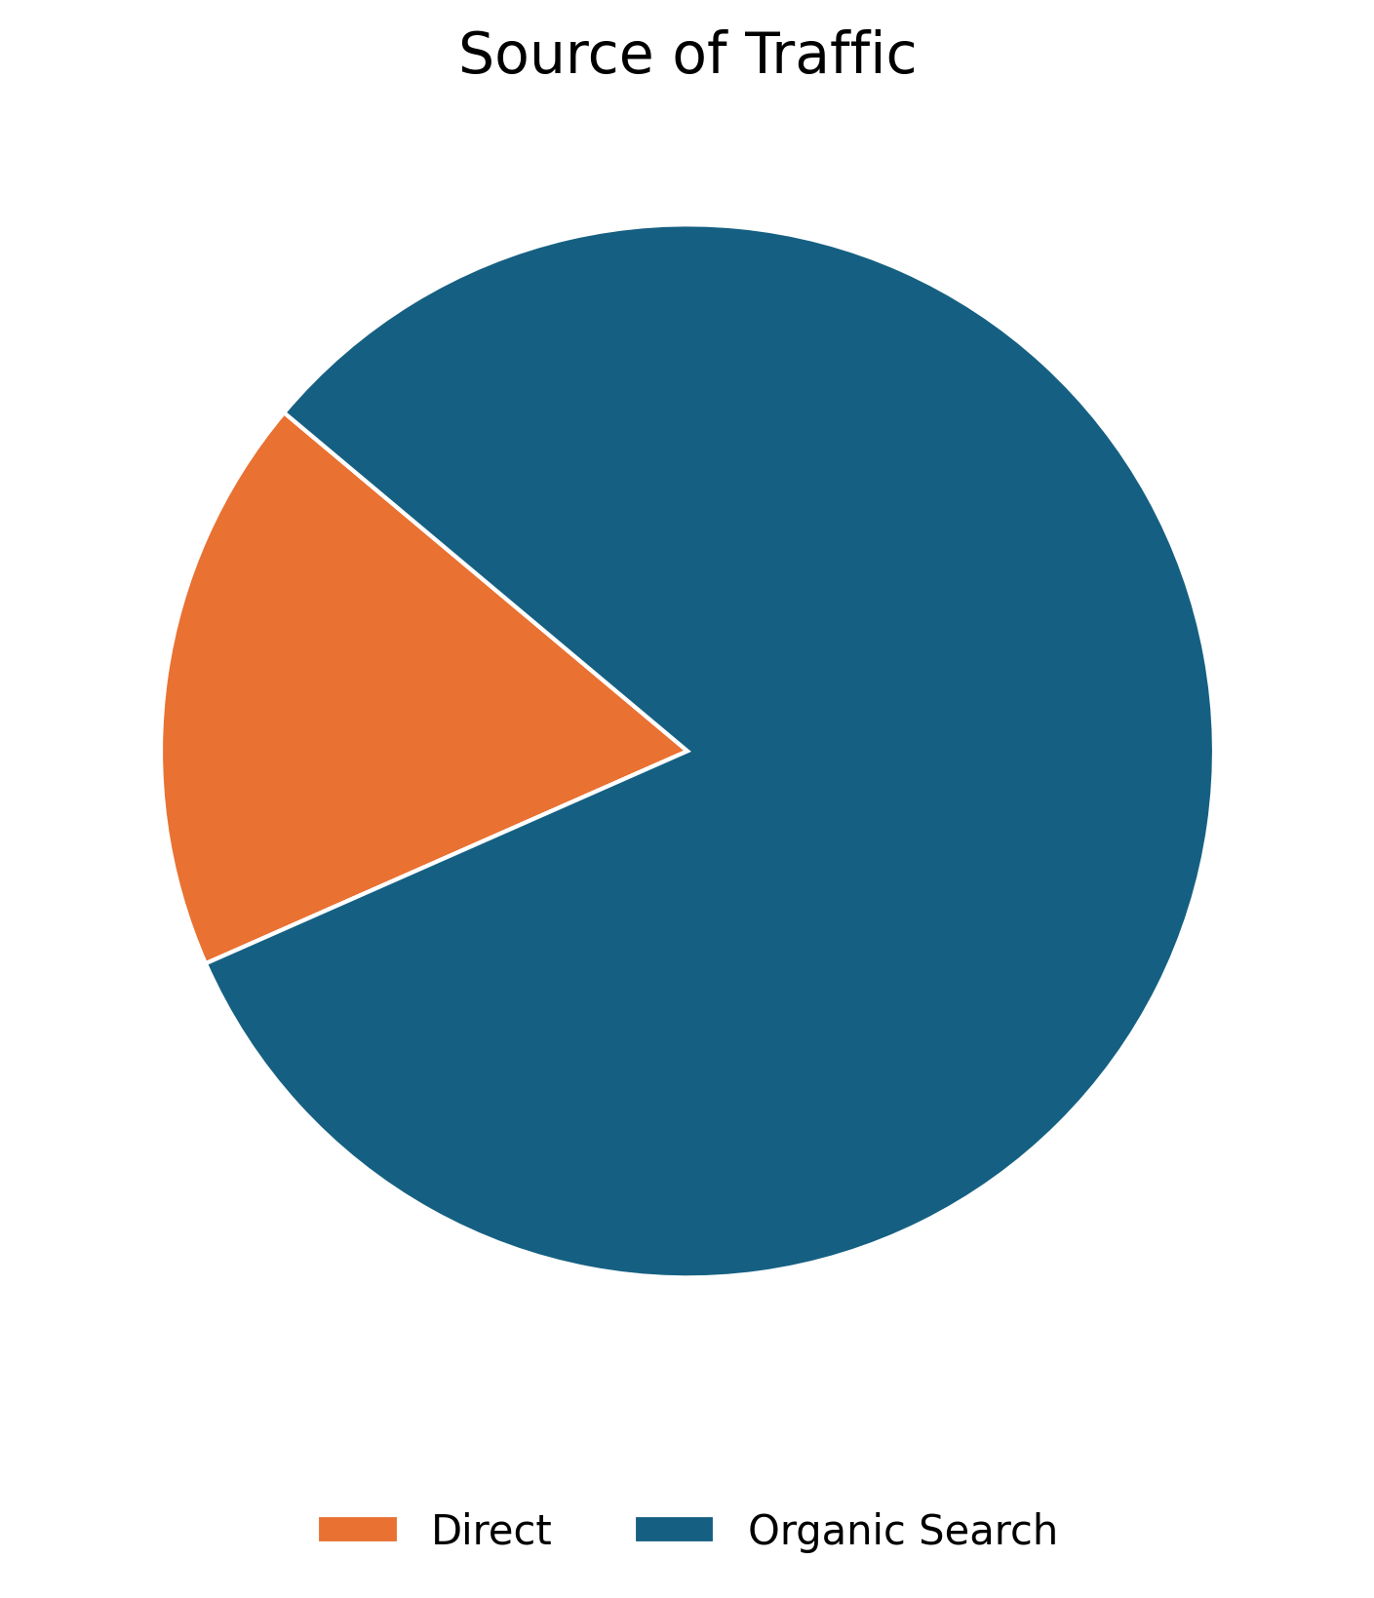
01 July 2025
User Acquisition
The data on this slide illustrates the various traffic channels bringing users to the EcoCash website. The pie chart reveals that the majority of traffic comes from Organic Search, which refers to unpaid search engine results generated based on their relevance to the user's query.
Source | Users
Organic Search | 21,900
Direct | 4,717

Slide 8
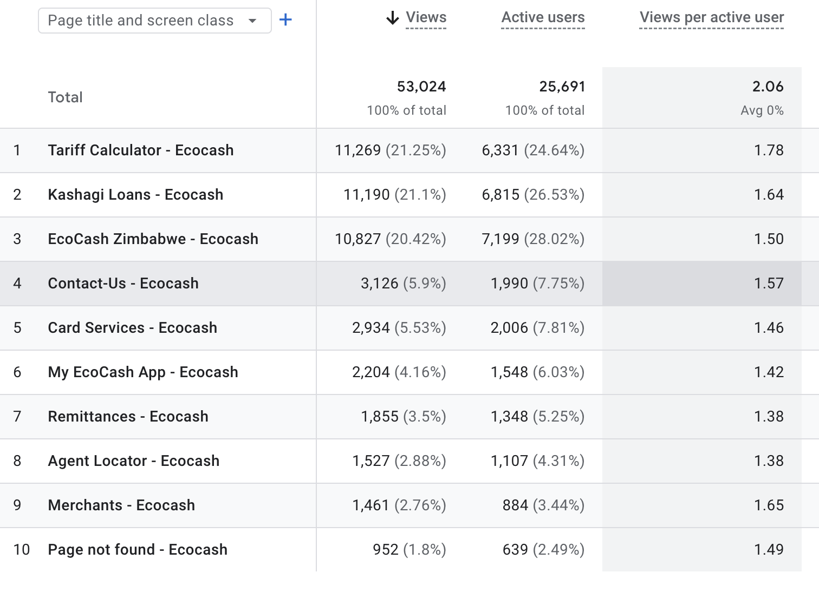

02 March 2026
Pages Sessions
The table shows the top pages visited by users in the previous month

Slide 9
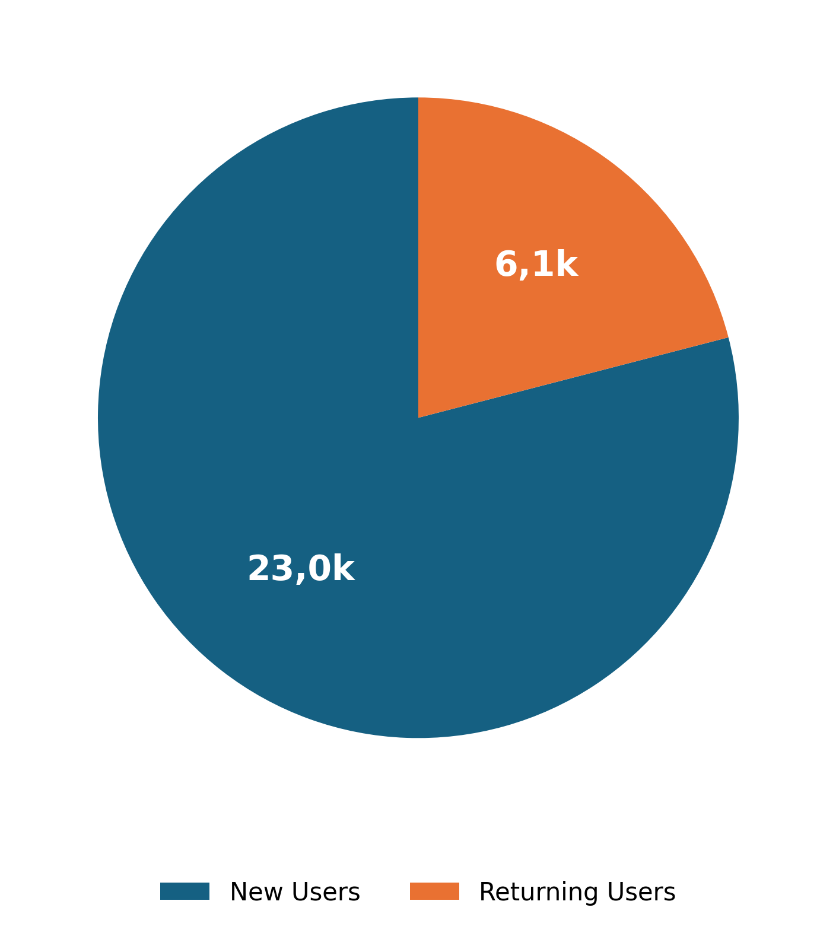
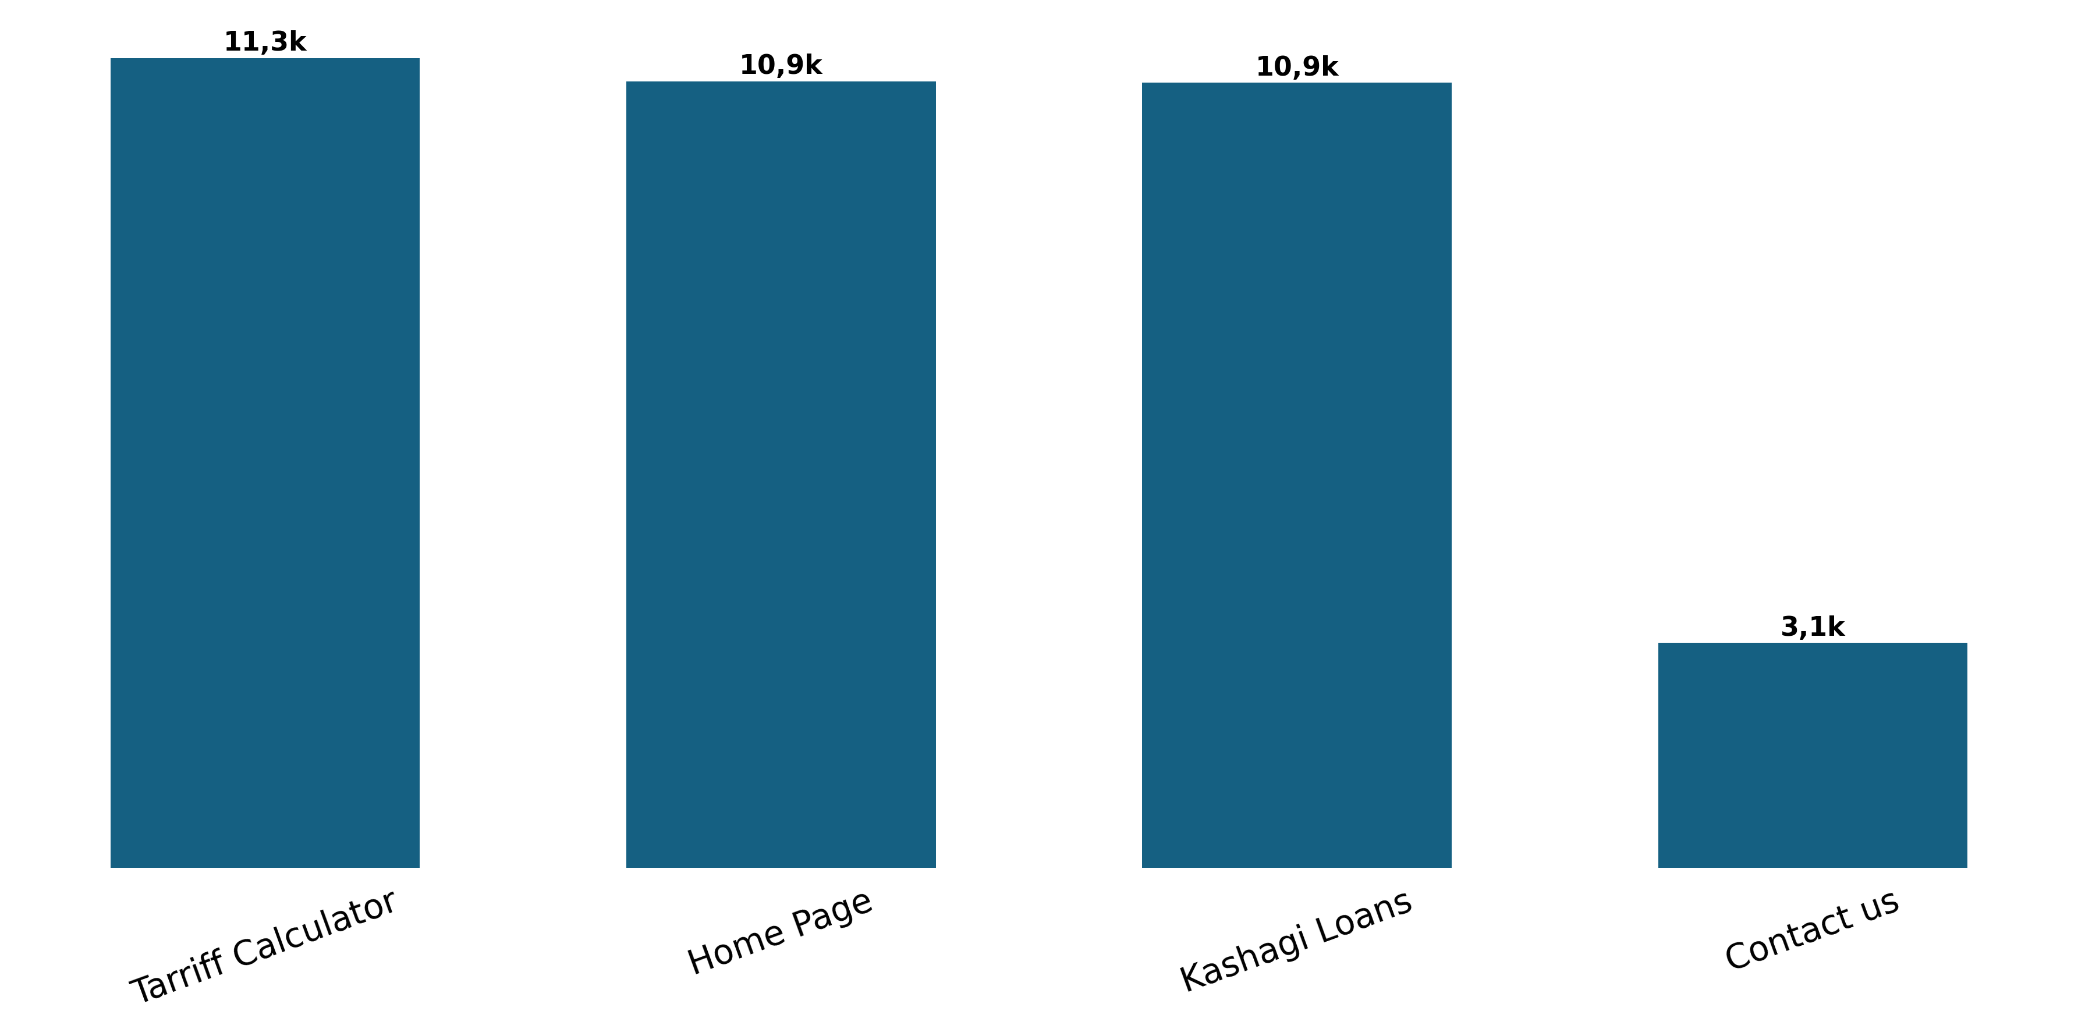
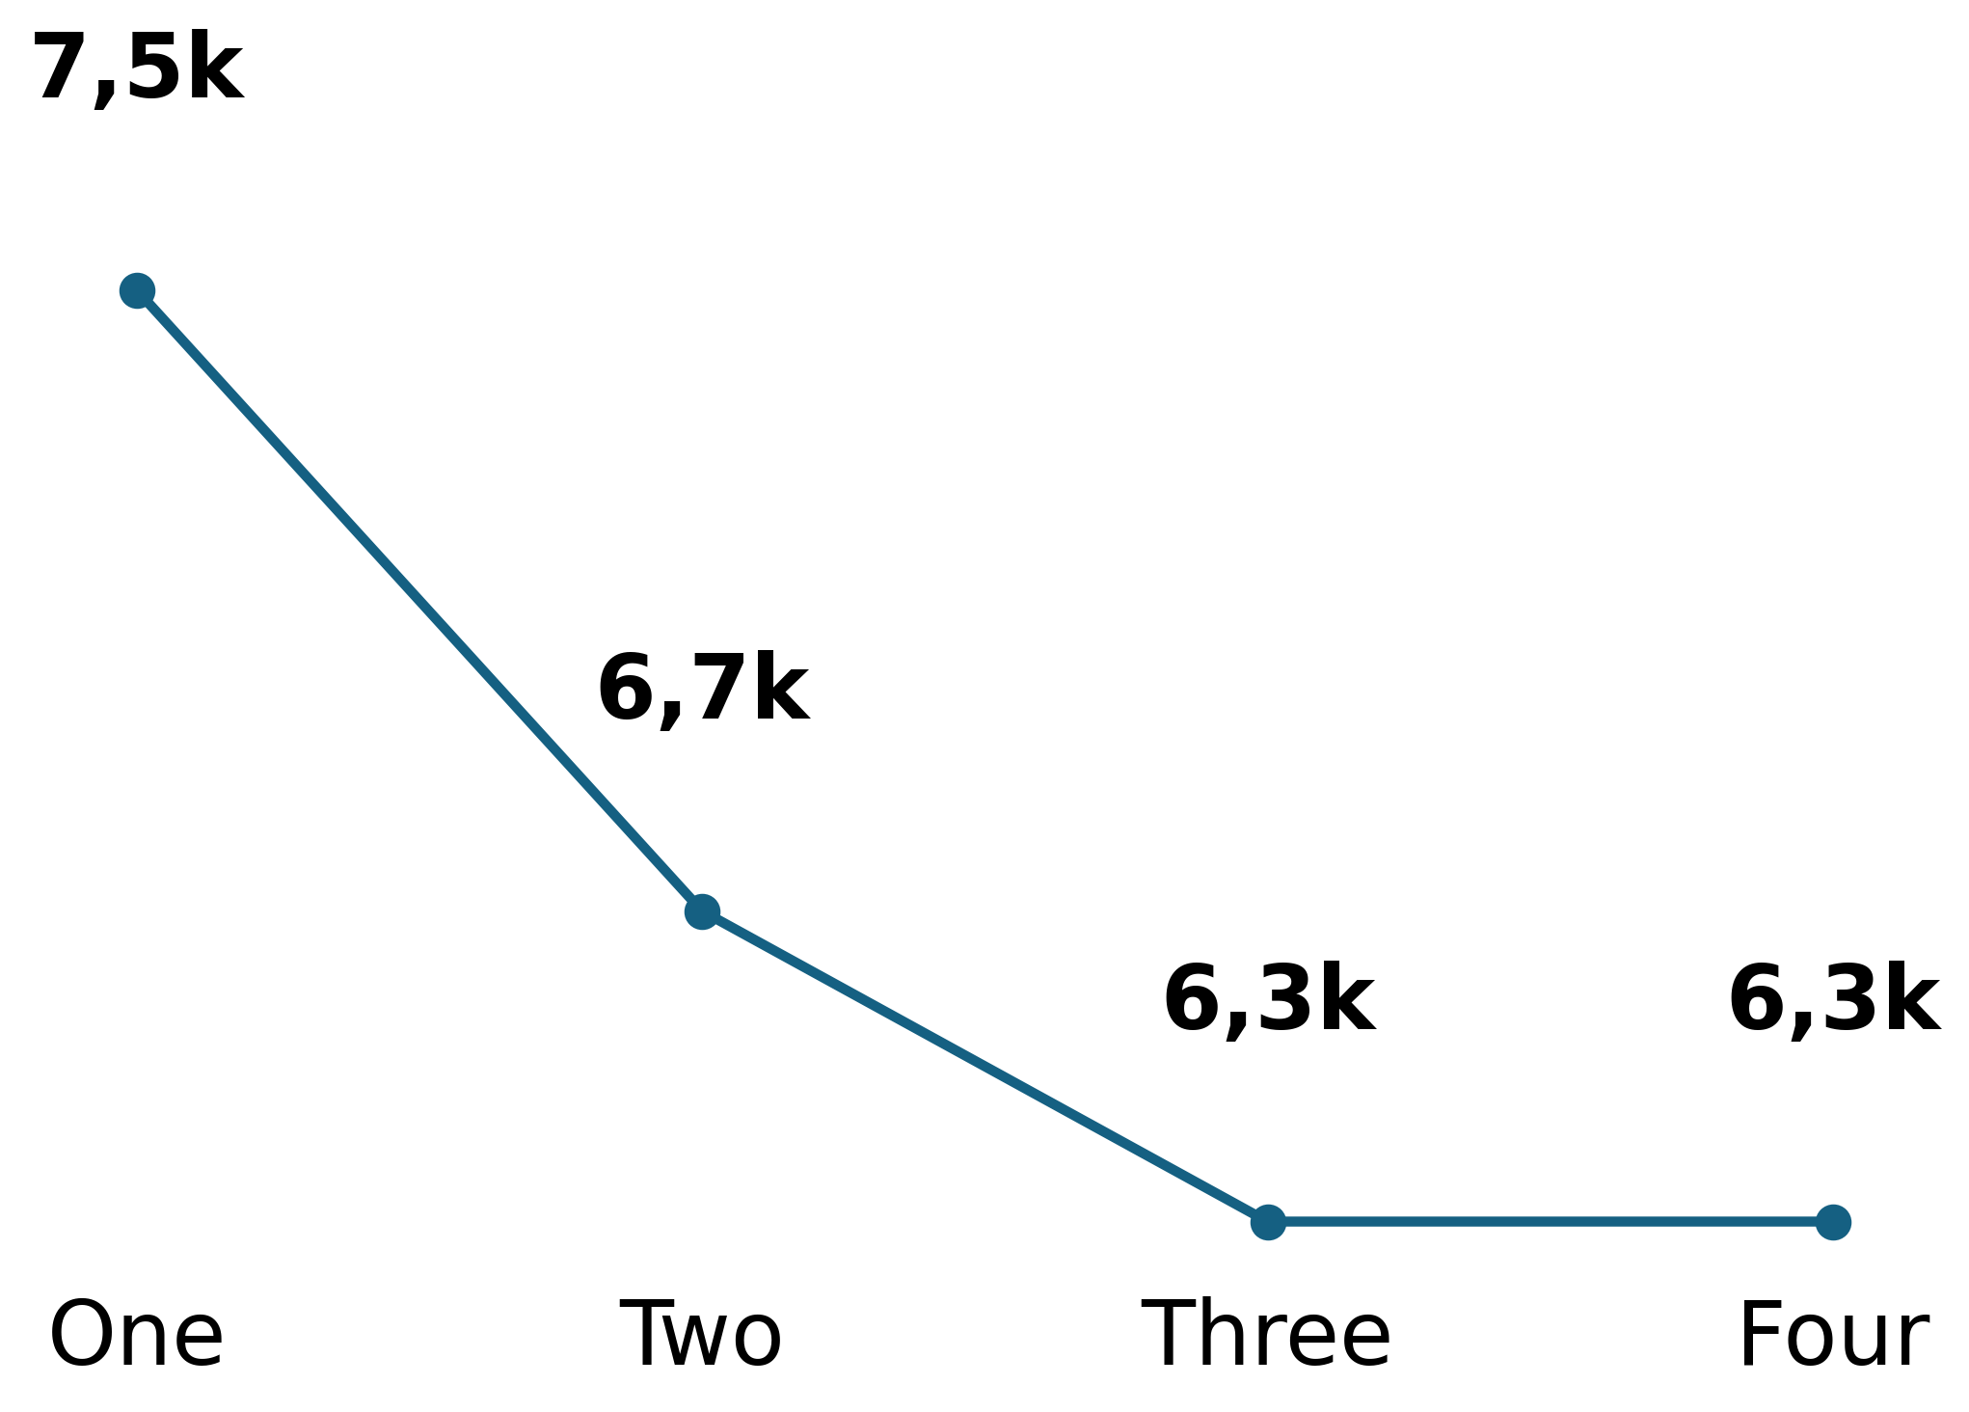
02 March 2026
Behavior Analysis
Users
Engagement Rate Per Week
Page Views
Based on user interactions.
Measure user interaction.
Track page visits.

Slide 10

02 March 2026
Recommendations
Based on data insights
1. Enhance User Engagement: Host promotional banners and seasonal advertisements directly on the Tariff Calculator and Kashagi Loans pages.
2. Increase Returning Users: Introduce a "Save My Results" or "Email Quote" feature for users interacting with the loan and tariff calculation tools.
3. Increase Active Users: Implement an educational "How-To" video series or a "Tips of the Month" section on the Home Page to explain product benefits.

